Slide 1
Tulecom Solutions
Group Overview

Slide 2
About us
Tulecom Group is a technology services and management consulting company.
Mission:
  Collaborate with companies to facilitate them reach their objectives, optimizing technological and human factors.
Values:
  Commitment to go in the right direction
  Truthful Communication
  Efficiency and Competitiveness in corporate management
  Transparency in Financing
  Honesty and Fairness in dealing with customers
  Respect and Motivation in personnel management
  Responsibility and commitment to the social environment
Corporate Presentation

Slide 3
Consulting
Strategic and Technologic Consulting
  Knowledge. Good practices that allow organizations’ profitable assets in the present and to plan future demands, capitalizing internal knowledge.
  Technology. Enterprise management systems and tools to support organizations’ knowledge, communications, and specific developments.
  Information. Transform data into useful knowledge, providing mechanisms to assimilate and absorb information to solve problems.
Analyze organizations to identify enhancement opportunities, provide recommendations and develop implementation plans.
Corporate Presentation

Slide 4
Research & Development - Guidelines (I)
Network Services:
  Advisory, design, development, expert knowledge, marketing
  Internet, Intranet and Extranet Solutions
  Web and Grid Services
  Ad-hoc Networking
Ambient Intelligence:
  e-Health solutions and developments
  Intelligent Environments
  Digital Home
  Home Automation
  Remote-Assistance
Corporate Presentation

Slide 5
Research & Development - Guidelines (II)
RFID Applications:
  Context Awareness
  Tagging Context
  Data Management Solutions
Information Systems:
  Data collection and data provider systems
  Customized information delivering on demand and spontaneously
Generic Architectures:
  Middleware research and development
  Technologies integration through software applications
Corporate Presentation

Slide 6
Research & Development - Scenarios (I)
Health Care:
  Use technology advances in order to improve quality of live
  Improve efficiency in hospitals and nursing homes
  Automatic localization and management of medicines and medical equipment
Elderly and Assisted Living:
  Improve efficiency in nursing home
  Improve quality of live to elder and disabled people
  Home automation and customized ambients and situations
Corporate Presentation

Slide 7
Research & Development - Scenarios (II)
Education:
  Apply Ambient Intelligence paradigm in educational scenarios.
  e-Learning applications based in context and personal knowledge.
  Information Management and Data Analysis
Conference:
  Provide intelligence, Ambient Intelligence, in any meeting events (congresses, conferences, conventions, etc.)
  Provide ubiquitous and transparent services to users
  Develop value added services
Corporate Presentation

Slide 8
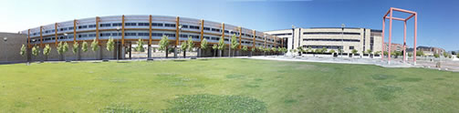


Research & Development - Units
R&D Laboratory
  R&D Laboratory immersed in the University of Salamanca Scientist and Technology Park
BISITE Group:
  Strong collaboration with BISITE Research Group (University of Salamanca)
  Ambient Intelligent, Multi-agent systems and RFID research
Corporate Presentation

Slide 9
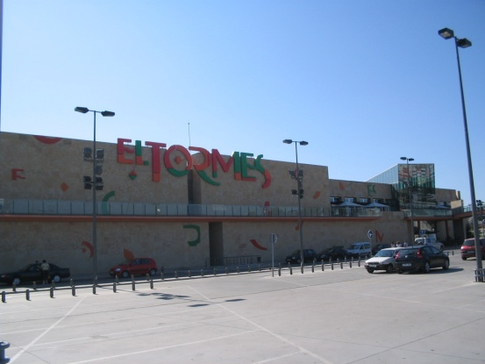
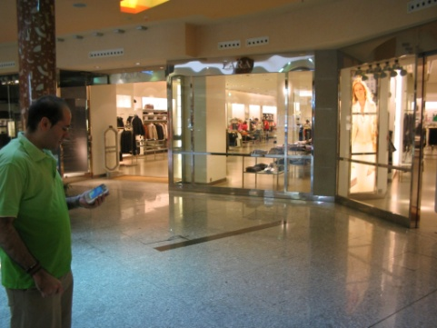
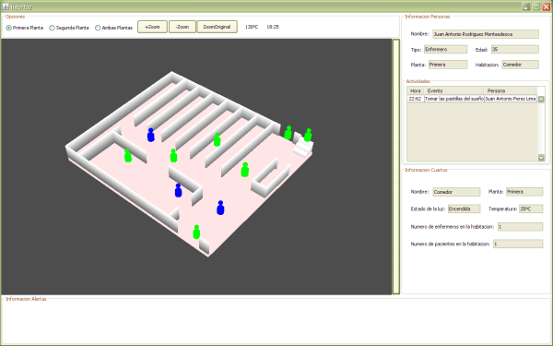
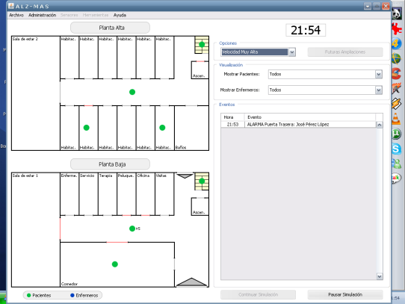
RFID Area (I)
Logistics:
  Supply chain, Products management, Transportation, Real-time stock, etc.
  UHF Passive Technology -> EPC Class1, Gen2.
Payment Systems:
  LF & HF Technology - NFC
  Contactless technology
  Security Improvement
  Parking applications
RTLS:
  UHF and Microwave Active Technology
  BISITE (University of Salamanca) Tracking System
Corporate Presentation

Slide 10





RFID Area (II)
Access Control
  Tulecom provides a hands-free access control solution with many advantages over traditional access control badges and systems
Information Services
  Data management to create Intelligent Places based in Tagging Context
Technology Integration
  Wireless Communications
  NFC, Wi-Fi, Bluetooth, ZigBee, WiMAX, etc.
  Tulecom combines technologies, in order to complement each other
Corporate Presentation

Slide 11


Current RFID Projects
AFA
  Access Control and Data Management to improve shift works
ALIADO
  Efficiency and Security Improvement in Alzheimer patients care
LOCALIZA
  RTLS using active RFID Research in new methods to reduce error rate
Corporate Presentation
AFA Salamanca

Slide 12





































Strategic Alliances
Universities (Research Groups, Foundations, etc.)
Companies & Business networks
Public Administration
Civil Society & Others
Corporate Presentation
AFA Salamanca

Slide 13
Headquarters: Salamanca, Spain.
Offices:
Phone:
Mail:
Web: www.tulecom.com

